Slide 1


Foundations of
Scientific Computing
(SciComp 101)
Dave Biersach
dbiersach@bnl.gov
Task 05

Slide 2
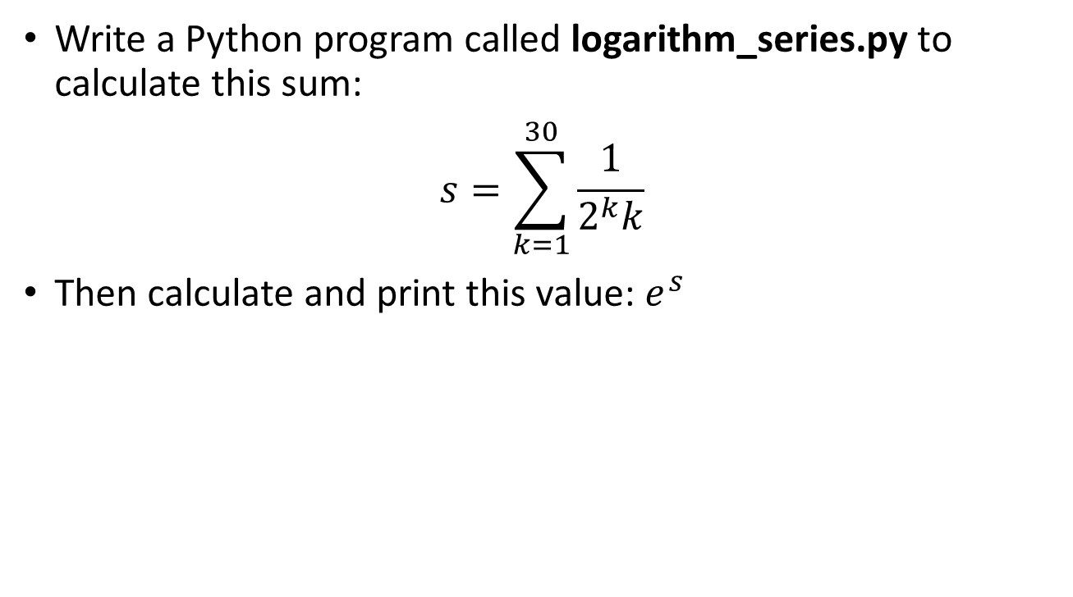
Task 05
Write a Python program called logarithm_series.py to calculate this sum:
$$s=\sum_{k=1}^{30}{\frac{1}{2^{k}k}}$$
Then calculate and print this value: $e^{s}$

Slide 3
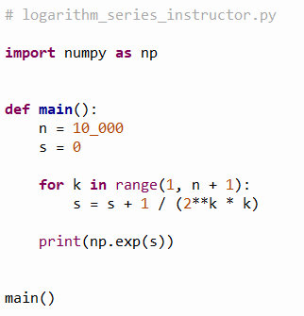
Open logarithm_series.py
①
②
③
$$s=\sum_{k=1}^{∞}{\frac{1}{2^{k}k}}$$
$$\frac{1}{0}$$
④
$$e^{s}$$
⑤
⑥

Slide 4
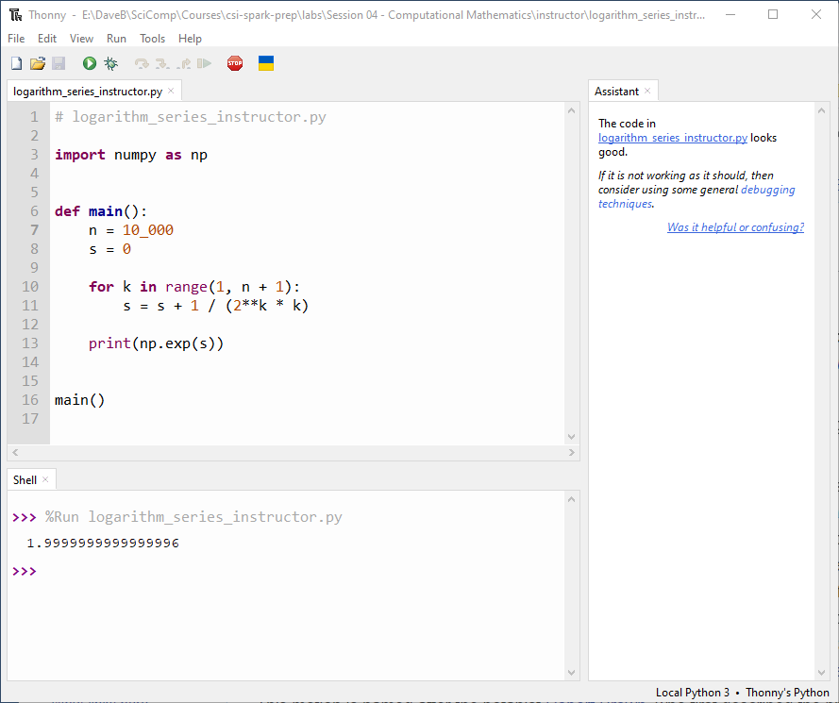
Run logarithm_series.py
$$\sum_{k=1}^{∞}{\frac{1}{2^{k}k}}=\ln{2}$$

Slide 5
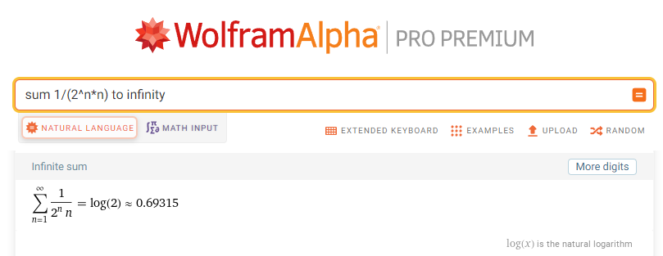
Run logarithm_series_instructor.py
$$e^{\ln{2}}=2$$
$$\sum_{k=1}^{∞}{\frac{1}{2^{k}k}}=\ln{2}$$

